Slide 1






Introduction to Entity Framework Core
The ORM Concept, Config, CRUD Operations
Entity
Framework Core
SoftUni Team
SQL
Technical Trainers
Software University
http://softuni.bg

Slide 2

Table of Contents
Entity Framework Core Overview
Database First Model
CRUD Operations Using Entity Framework
Working with LINQ

Slide 3
Questions
sli.do #CSharpDB

Slide 4

Entity Framework Core
Overview and Features

Slide 5
Entity Framework Core: Overview
The standard ORM framework for .NET and .NET Core
Provides LINQ-based data queries and CRUD operations
Automatic change tracking of in-memory objects
Works with many relational databases (with different providers)
Open source with independent release cycle
github.com/aspnet/EntityFrameworkCore

Slide 6
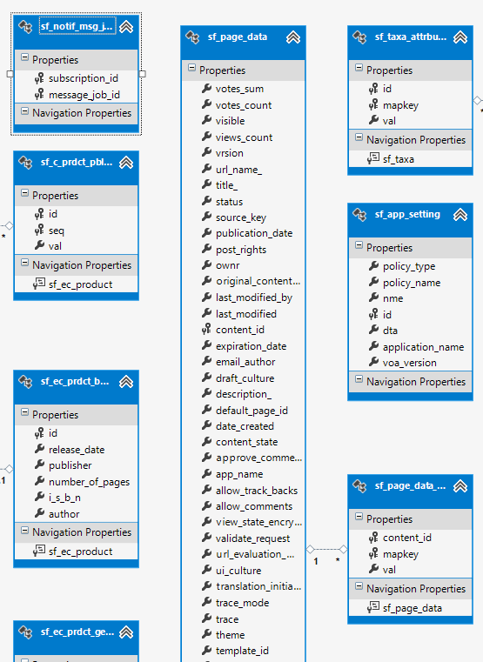
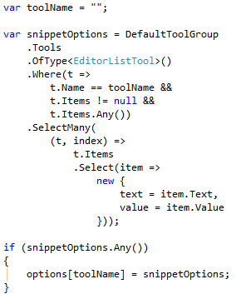
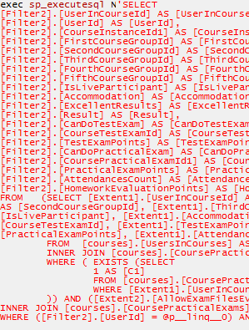
EF Core: Basic Workflow
Define the data model (Code First or Scaffold from DB)
Write & execute query over IQueryable
EF generates & executes an SQL query in the DB

Slide 7
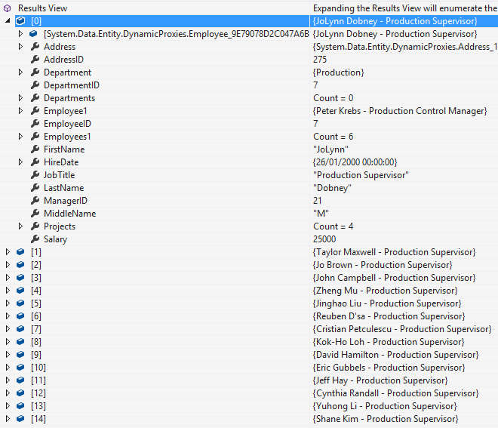
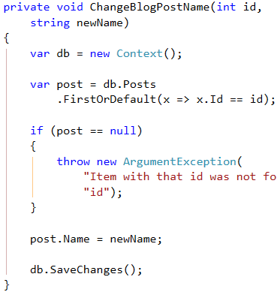
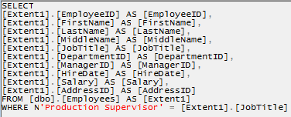
EF Core: Basic Workflow (2)
EF transforms the query results into .NET objects
Modify data with C# code and call "Save Changes()"
Entity Framework generates & executes SQL command to modify the DB

Slide 8
Entity Framework Core: Setup
To add EF Core support to a project in Visual Studio:
Install it from Package Manager Console
EF Core is modular – any data providers must be installed too:
Install-Package Microsoft.EntityFrameworkCore
Install-Package Microsoft.EntityFrameworkCore.SqlServer

Slide 9
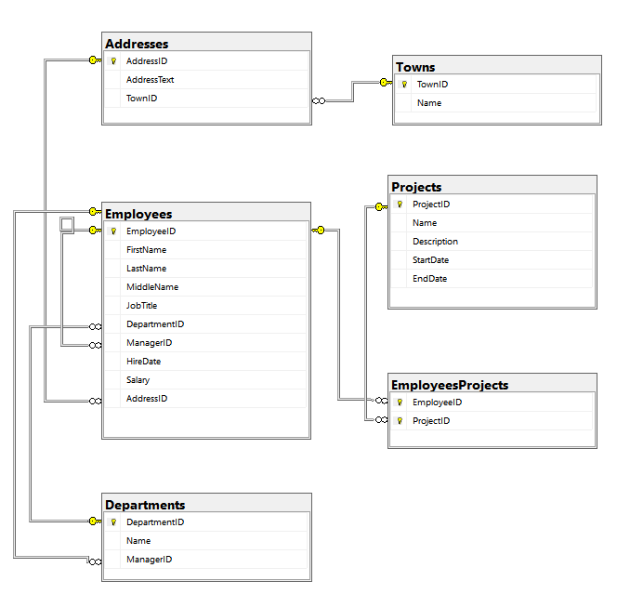
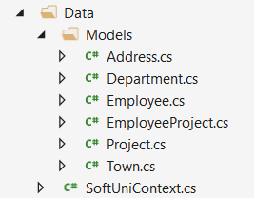
Database First Model
Database First model models the entity classes after the database

Slide 10
Database First Model: Setup
Scaffolding DbContext from DB with Scaffold-DbContext command in Package Manager Console:
Scaffolding requires the following packages beforehand:
Scaffold-DbContext
-Connection "Server=.;Database=…;Integrated Security=True"
-Provider Microsoft.EntityFrameworkCore.SqlServer
-OutputDir Data
Install-Package Microsoft.EntityFrameworkCore.Tools
Install-Package Microsoft.EntityFrameworkCore.SqlServer.Design

Slide 11
EF Components
The DbContext class
Holds the database connection and the entity classes
Provides LINQ-based data access
Provides identity tracking, change tracking, and an API for CRUD operations
Entity classes
Hold entities (objects with their attributes and relations)
Each database table is typically mapped to a single C# class

Slide 12
EF Components (2)
Associations (relationship mappings)
An association is a primary key / foreign key-based relationship between two entity classes
Allows navigation from one entity to another
Concurrency control
Entity Framework uses optimistic concurrency control
No locking by default
Automatic concurrency conflict detection
var courses = student.Courses.Where(…);

Slide 13

Reading Data
Querying the DB using Entity Framework

Slide 14
The DbContext Class
DbContext provides:
CRUD Operations
A way to access entities
Methods for creating new entities (Add() method)
Ability to manipulate database data by modifying objects
Easily navigate through table relations
Executing LINQ queries as native SQL queries
Managing database creation/deletion/migration

Slide 15
Using DbContext Class
First create instance of the DbContext:
In the constructor you can pass a database connection string
DbContext properties:
Database – EnsureCreated/Deleted methods, DB Connection
ChangeTracker – Holds info about the automatic change tracker
All entity classes (tables) are listed as properties
e.g. DbSet<Employee> Employees { get; set; }
var context = new SoftUniDbContext();

Slide 16
Reading Data with LINQ Query
Executing LINQ-to-Entities query over EF entity:
Employees property in the DbContext:
using (var context = new SoftUniEntities())
{
var employees = context.Employees
.Where(e => e.JobTitle == "Design Engineer")
.ToArray();
}
EF translates this to an SQL query
public partial class SoftUniEntities : DbContext
{
public DbSet<Employee> Employees { get; set; }
public DbSet<Project> Projects { get; set; }
public DbSet<Department> Departments { get; set; }
}

Slide 17
Reading Data with LINQ Query
We can also use extension methods for constructing the query
Find element by ID
using (var context = new SoftUniEntities())
{
var employees = context.Employees
.Where(c => c.JobTitle == "Design Engineering")
.Select(c => c.FirstName)
.ToList();
}
ToList() materializes the query
using (var context = new SoftUniEntities())
{
var project = context.Projects.Find(2);
Console.WriteLine(project.Name);
}

Slide 18
LINQ: Simple Operations
Where()
Searches by given condition
First/Last() / FirstOrDefault/LastOrDefault()
Gets the first/last element which matches the condition
Throws InvalidOperationException without OrDefault
Select()
Projects (conversion) collection to another type
OrderBy() / ThenBy() / OrderByDescending()
Orders a collection

Slide 19
LINQ: Simple Operations (2)
Any()
Checks if any element matches a condition
All()
Checks if all elements match a condition
Distinct()
Returns only unique elements
Skip() / Take()
Skips or takes X number of elements

Slide 20
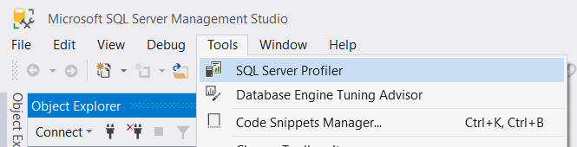
Logging the Native SQL Queries
Queries sent to SQL Server can be monitored with SQL Server Profiler
Included in SQL Server Management Studio:
Queries can also be monitored with Express Profiler
https://expressprofiler.codeplex.com/

Slide 21
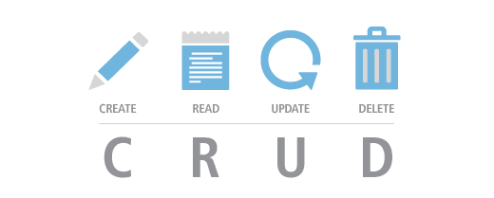
CRUD Operations
With Entity Framework

Slide 22
Creating New Data
To create a new database row use the method Add(…) of the corresponding DbSet:
Create a new Project object
var project = new Project()
{
Name = "Judge System",
StartDate = new DateTime(2015, 4, 15),
};
context.Projects.Add(project);
context.SaveChanges();
Add the object to the DbSet
Execute SQL statements

Slide 23
Cascading Inserts
We can also add cascading entities to the database:
The Project will be added when the Employee entity (employee) is inserted to the database
Employee employee = new Employee();
employee.FirstName = "Petya";
employee.LastName = "Grozdarska";
employee.Projects.Add(new Project { Name = "SoftUni Conf"} );
softUniEntities.Employees.Add(employee);
softUniEntities.SaveChanges();

Slide 24
Updating Existing Data
DbContext allows modifying entity properties and persisting them in the database
Just load an entity, modify it and call SaveChanges()
The DbContext automatically tracks all changes made on its entity objects
Employees employee =
softUniEntities.Employees.First();
employees.FirstName = "Alex";
context.SaveChanges();
SELECT the first order
Execute an SQL UPDATE

Slide 25
Deleting Existing Data
Delete is done by Remove() on the specified entity collection
SaveChanges() method performs the delete action in the database
Mark the entity for deleting at the next save
Employees employee =
softUniEntities.Employees.First();
softUniEntities.Employees.Remove(employee);
softUniEntities.SaveChanges();
Execute the SQL DELETE command

Slide 26
Summary
ORM frameworks maps database schema to objects in a programming language
Entity Framework Core is the standard .NET ORM
LINQ can be used to query the DB through the DB context
var employees = context.Employees
.Where(c => c.JobTitle == "Design Engineering")
.Select(c => c.FirstName)
.ToList();

Slide 27







Introduction to Entity Framework Core
https://softuni.bg/courses/databases-basics-ms-sql-server

Slide 28






SoftUni Diamond Partners

Slide 29






SoftUni Diamond Partners

Slide 30
License
This course (slides, examples, demos, videos, homework, etc.) is licensed under the "Creative Commons Attribution-NonCommercial-ShareAlike 4.0 International" license
Attribution: this work may contain portions from
"Databases" course by Telerik Academy under CC-BY-NC-SA license

Slide 31





Trainings @ Software University (SoftUni)
Software University – High-Quality Education, Profession and Job for Software Developers
softuni.bg
Software University Foundation
http://softuni.foundation/
Software University @ Facebook
facebook.com/SoftwareUniversity
Software University Forums
forum.softuni.bg

